Slide 1

Shopping Website – Daily Frontend Progress Report
Date: 30th July 2025
Developer: Ome Prakash

Slide 2


Today's Objectives :
Implement cart system with:
Cart count notification on all pages
Product details and image display in the cart
Improve search functionality
Prepare account page with placeholders for order history
Finalize frontend design and animations

Slide 3

Cart Page Features :
Displayed:
Product name
Product image
Price
Remove button
Cart Summary section:
Total MRP
Discount (10% if items exist)
Platform fee (₹20)
Final total

Slide 4

Cart Notification :
Notification badge appears on cart icon
Badge updates live when item is added or removed
Shared across:
Products page
Cart page
Account page

Slide 5

Search Bar :
Live search feature implemented
User can:
Type in product name/keywords
Filter visible product cards dynamically
Smooth UI transition with CSS

Slide 6


Account Page Setup :
Displays user profile details:
Name, Email, Phone, Username
Sidebar for future features:
Order history
Coupons
Search and logout options functional
Ready for backend integration (Spring Boot & MySQL)

Slide 7
Design Enhancements :
Gradient backgrounds and animations
Responsive buttons with hover effects
Clean layout for:
Cart
Account
Navigation
Icons, images, and brand logos added

Slide 8
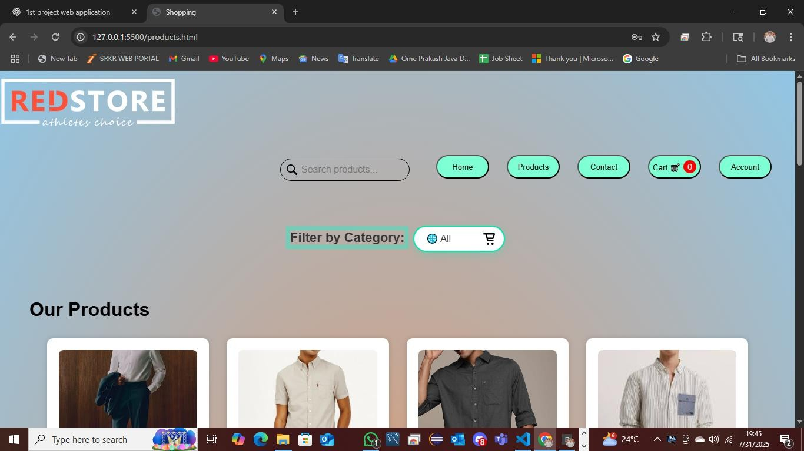
Output :

Slide 9
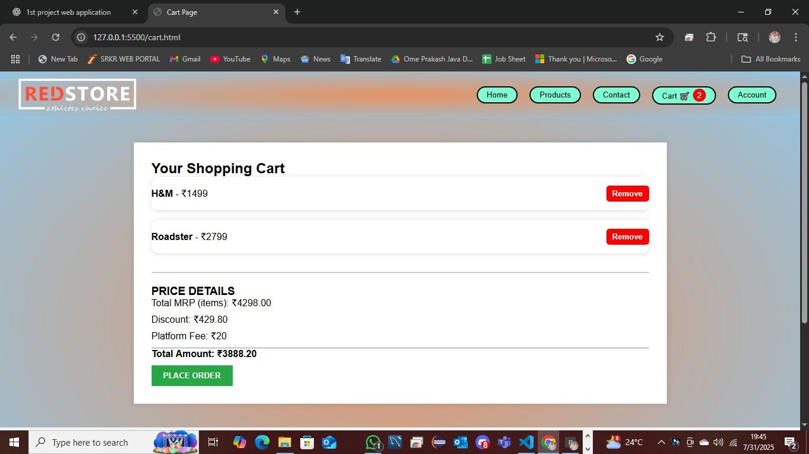
Output :

Slide 10
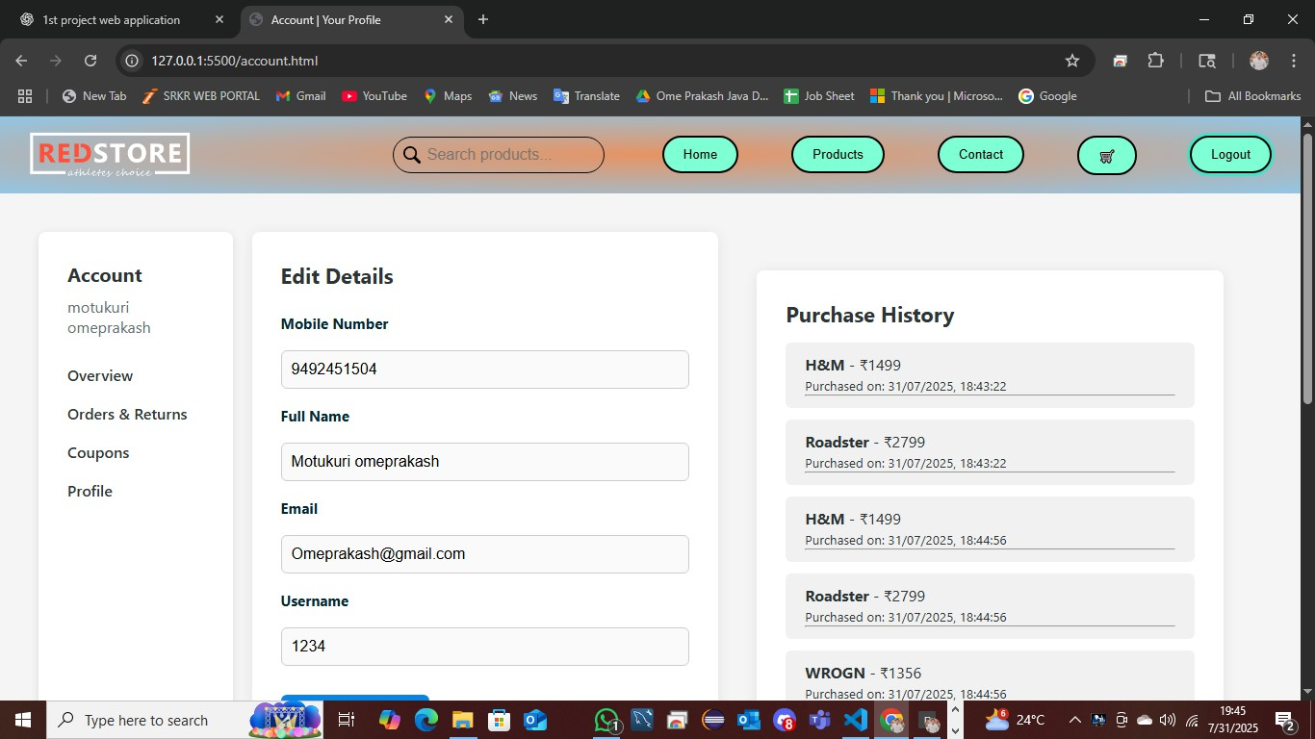
Output:

Slide 11
Final Result :
Frontend fully completed
All cart, search, and account features working as expected
Now ready to move into backend development phase

